Slide 1
Marshell Yang

Slide 2
2025 EOY Bonus

Slide 3
Bonus
Bonus Depends on company results & your results
2025 sales were down vs. 2024 and vs. our target.
However, we did a better job of managing our costs and improved our profitability.
Flyers can receive up to 100% of their bonus.
Your 2025 Bonus Potential
RMB 1,032 1 Months
Your 2025 Actual Bonus
RMB 2,078 2 Months 1% of Potential

Slide 4
2026

Slide 5
2026 Salary
Current Salary
RMB 3,032 Per month
2026 Salary
RMB 4,094 Per month
Merit Increase %
8 %
2026 Bonus Potential
RMB 5,046 1 Months

Slide 6
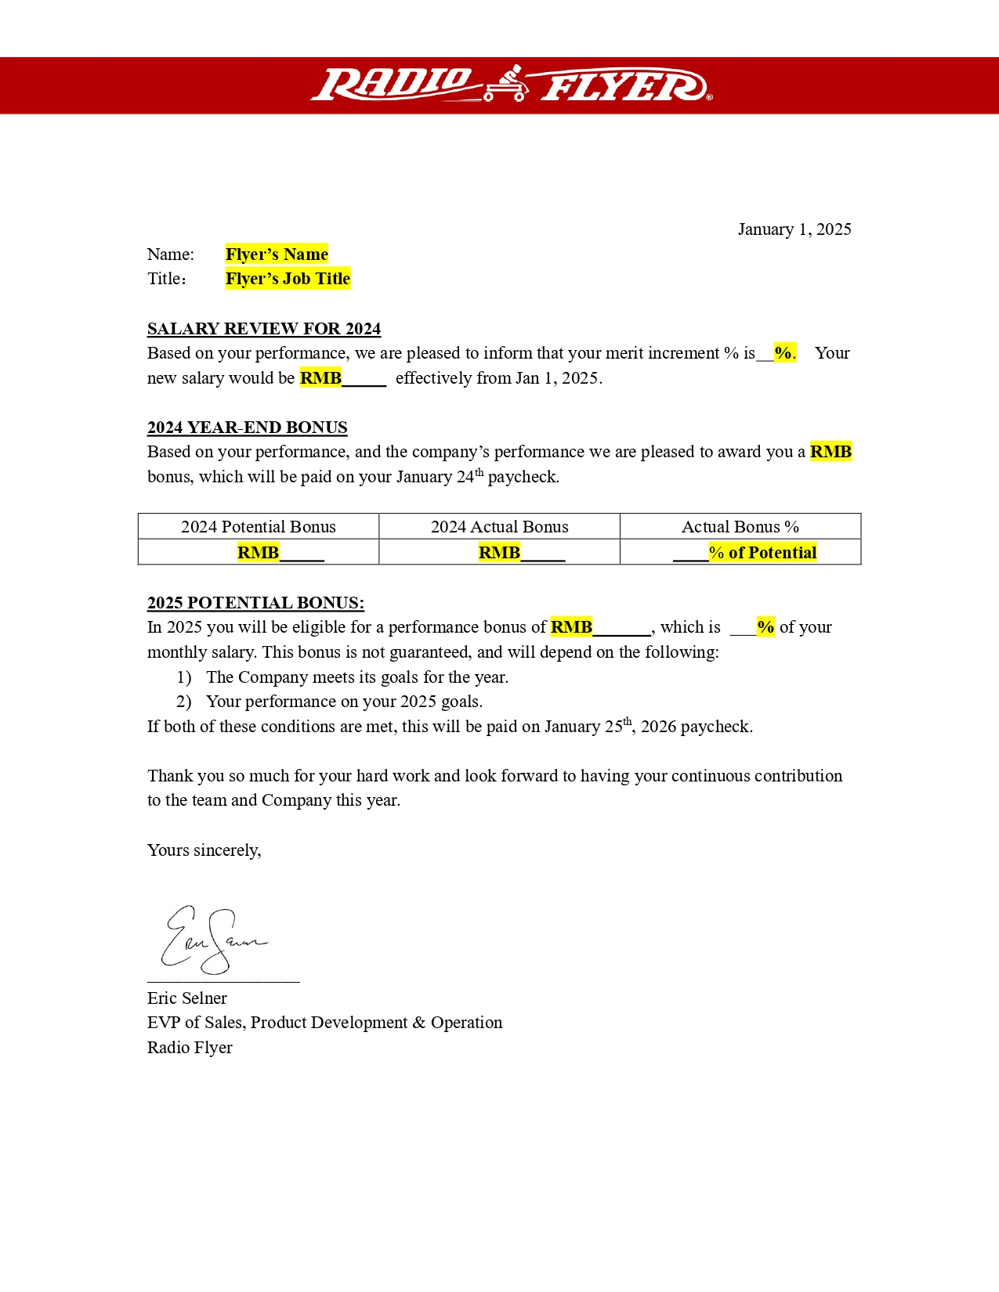
Image: Flyer’s salary letter

Slide 8
Shirley Huang

Slide 9
2025 EOY Bonus

Slide 10
Bonus
Bonus Depends on company results & your results
2025 sales were down vs. 2024 and vs. our target.
However, we did a better job of managing our costs and improved our profitability.
Flyers can receive up to 100% of their bonus.
Your 2025 Bonus Potential
RMB 1,071 9 Months
Your 2025 Actual Bonus
RMB 2,082 8 Months 0% of Potential

Slide 11
2026

Slide 12
2026 Salary
Current Salary
RMB 3,032 Per month
2026 Salary
RMB 4,015 Per month
Merit Increase %
0 %
2026 Bonus Potential
RMB 5,088 7 Months

Slide 13
Image: Flyer’s salary letter

Slide 15
Connie Tang

Slide 16
2025 EOY Bonus

Slide 17
Bonus
Bonus Depends on company results & your results
2025 sales were down vs. 2024 and vs. our target.
However, we did a better job of managing our costs and improved our profitability.
Flyers can receive up to 100% of their bonus.
Your 2025 Bonus Potential
RMB 1,057 9 Months
Your 2025 Actual Bonus
RMB 2,053 1 Months 8% of Potential

Slide 18
2026

Slide 19
2026 Salary
Current Salary
RMB 3,068 Per month
2026 Salary
RMB 4,048 Per month
Merit Increase %
7 %
2026 Bonus Potential
RMB 5,035 8 Months

Slide 20
Image: Flyer’s salary letter

Slide 22
Anny Li

Slide 23
2025 EOY Bonus

Slide 24
Bonus
Bonus Depends on company results & your results
2025 sales were down vs. 2024 and vs. our target.
However, we did a better job of managing our costs and improved our profitability.
Flyers can receive up to 100% of their bonus.
Your 2025 Bonus Potential
RMB 1,054 1 Months
Your 2025 Actual Bonus
RMB 2,070 5 Months 5% of Potential

Slide 25
2026

Slide 26
2026 Salary
Current Salary
RMB 3,043 Per month
2026 Salary
RMB 4,056 Per month
Merit Increase %
6 %
2026 Bonus Potential
RMB 5,047 1 Months

Slide 27
Image: Flyer’s salary letter

Slide 29
Chloe Ke

Slide 30
2025 EOY Bonus

Slide 31
Bonus
Bonus Depends on company results & your results
2025 sales were down vs. 2024 and vs. our target.
However, we did a better job of managing our costs and improved our profitability.
Flyers can receive up to 100% of their bonus.
Your 2025 Bonus Potential
RMB 1,078 8 Months
Your 2025 Actual Bonus
RMB 2,037 4 Months 9% of Potential

Slide 32
2026

Slide 33
2026 Salary
Current Salary
RMB 3,052 Per month
2026 Salary
RMB 4,085 Per month
Merit Increase %
1 %
2026 Bonus Potential
RMB 5,052 2 Months

Slide 34
Image: Flyer’s salary letter

Slide 36
Harvey Xie

Slide 37
2025 EOY Bonus

Slide 38
Bonus
Bonus Depends on company results & your results
2025 sales were down vs. 2024 and vs. our target.
However, we did a better job of managing our costs and improved our profitability.
Flyers can receive up to 100% of their bonus.
Your 2025 Bonus Potential
RMB 1,046 0 Months
Your 2025 Actual Bonus
RMB 2,007 1 Months 7% of Potential

Slide 39
2026

Slide 40
2026 Salary
Current Salary
RMB 3,028 Per month
2026 Salary
RMB 4,099 Per month
Merit Increase %
1 %
2026 Bonus Potential
RMB 5,077 4 Months

Slide 41
Image: Flyer’s salary letter

Slide 43
Aben Chen

Slide 44
2025 EOY Bonus

Slide 45
Bonus
Bonus Depends on company results & your results
2025 sales were down vs. 2024 and vs. our target.
However, we did a better job of managing our costs and improved our profitability.
Flyers can receive up to 100% of their bonus.
Your 2025 Bonus Potential
RMB 1,040 8 Months
Your 2025 Actual Bonus
RMB 2,032 1 Months 2% of Potential

Slide 46
2026

Slide 47
2026 Salary
Current Salary
RMB 3,026 Per month
2026 Salary
RMB 4,075 Per month
Merit Increase %
3 %
2026 Bonus Potential
RMB 5,052 0 Months

Slide 48
Image: Flyer’s salary letter

Slide 50
Derek Wang

Slide 51
2025 EOY Bonus

Slide 52
Bonus
Bonus Depends on company results & your results
2025 sales were down vs. 2024 and vs. our target.
However, we did a better job of managing our costs and improved our profitability.
Flyers can receive up to 100% of their bonus.
Your 2025 Bonus Potential
RMB 1,095 7 Months
Your 2025 Actual Bonus
RMB 2,076 1 Months 8% of Potential

Slide 53
2026

Slide 54
2026 Salary
Current Salary
RMB 3,093 Per month
2026 Salary
RMB 4,052 Per month
Merit Increase %
5 %
2026 Bonus Potential
RMB 5,074 5 Months

Slide 55
Image: Flyer’s salary letter

Slide 57
Steven Wei

Slide 58
2025 EOY Bonus

Slide 59
Bonus
Bonus Depends on company results & your results
2025 sales were down vs. 2024 and vs. our target.
However, we did a better job of managing our costs and improved our profitability.
Flyers can receive up to 100% of their bonus.
Your 2025 Bonus Potential
RMB 1,006 7 Months
Your 2025 Actual Bonus
RMB 2,003 9 Months 8% of Potential

Slide 60
2026

Slide 61
2026 Salary
Current Salary
RMB 3,068 Per month
2026 Salary
RMB 4,018 Per month
Merit Increase %
8 %
2026 Bonus Potential
RMB 5,019 0 Months

Slide 62
Image: Flyer’s salary letter

Slide 64
Roland Liu

Slide 65
2025 EOY Bonus

Slide 66
Bonus
Bonus Depends on company results & your results
2025 sales were down vs. 2024 and vs. our target.
However, we did a better job of managing our costs and improved our profitability.
Flyers can receive up to 100% of their bonus.
Your 2025 Bonus Potential
RMB 1,031 5 Months
Your 2025 Actual Bonus
RMB 2,043 6 Months 6% of Potential

Slide 67
2026

Slide 68
2026 Salary
Current Salary
RMB 3,090 Per month
2026 Salary
RMB 4,023 Per month
Merit Increase %
4 %
2026 Bonus Potential
RMB 5,033 0 Months

Slide 69
Image: Flyer’s salary letter

Slide 71
Margaret Li

Slide 72
2025 EOY Bonus

Slide 73
Bonus
Bonus Depends on company results & your results
2025 sales were down vs. 2024 and vs. our target.
However, we did a better job of managing our costs and improved our profitability.
Flyers can receive up to 100% of their bonus.
Your 2025 Bonus Potential
RMB 1,084 6 Months
Your 2025 Actual Bonus
RMB 2,016 2 Months 1% of Potential

Slide 74
2026

Slide 75
2026 Salary
Current Salary
RMB 3,088 Per month
2026 Salary
RMB 4,052 Per month
Merit Increase %
1 %
2026 Bonus Potential
RMB 5,057 7 Months

Slide 76
Image: Flyer’s salary letter

Slide 78
Jay Guo

Slide 79
2025 EOY Bonus

Slide 80
Bonus
Bonus Depends on company results & your results
2025 sales were down vs. 2024 and vs. our target.
However, we did a better job of managing our costs and improved our profitability.
Flyers can receive up to 100% of their bonus.
Your 2025 Bonus Potential
RMB 1,047 2 Months
Your 2025 Actual Bonus
RMB 2,090 8 Months 4% of Potential

Slide 81
2026

Slide 82
2026 Salary
Current Salary
RMB 3,066 Per month
2026 Salary
RMB 4,042 Per month
Merit Increase %
4 %
2026 Bonus Potential
RMB 5,011 8 Months

Slide 83
Image: Flyer’s salary letter

